Slide 1
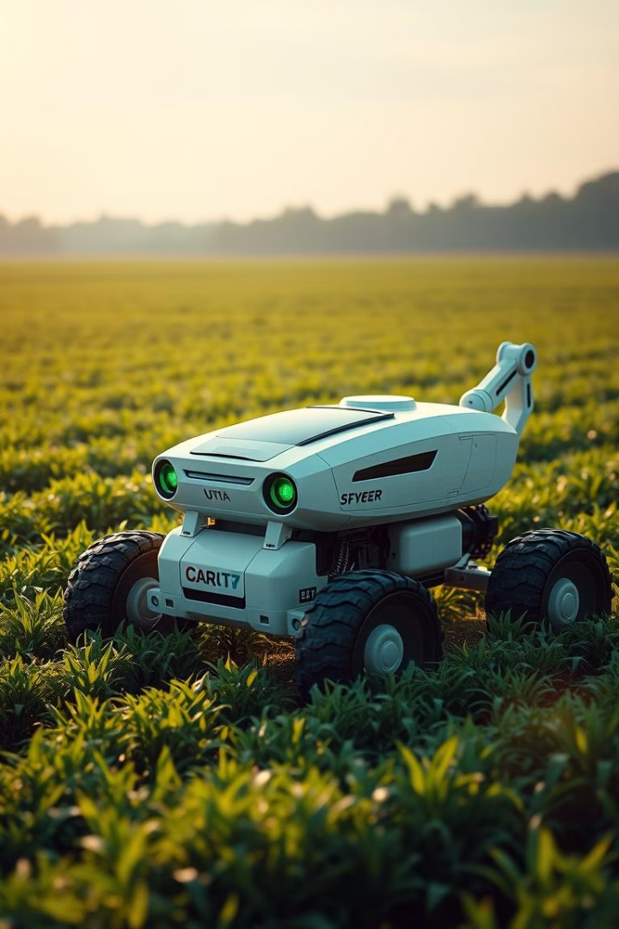
Agron AI: Revolutionizing Agriculture with Autonomous Robotics
Agron AI is an AI-powered rover designed to transform farming. It leverages AI, IoT, and robotics for intelligent automation. The aim is to reduce labor, optimize yield, and improve resource management. It ensures sustainable and efficient operations.

Slide 2
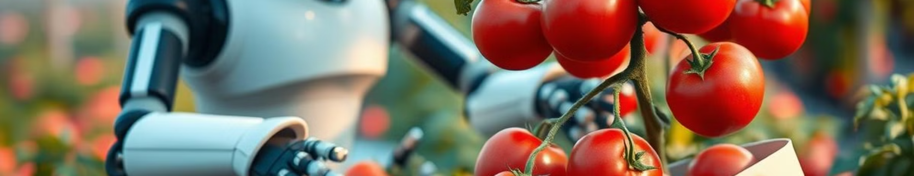



Key Objectives of Agron AI
Autonomous Harvesting
Efficient Produce Handling
AI-Driven Irrigation
Detect and harvest crops using AI vision and a robotic arm.
Handle harvested produce with a smart basket system.
Communicate with an AI-driven irrigation system to optimize water usage.

Slide 3
AI-Powered Object Detection & Harvesting
Pi Camera & AI Models
Robotic Arm
Detects and classifies fruits and vegetables with precision.
Controlled via Raspberry Pi. It plucks identified produce gently.

Slide 4




Smart Basket Handling System
Basket Capacity
Worker Alert
Resumes Operations
Rover stops when the basket is full.
A buzzer notifies workers to replace the basket.
Rover continues workflow after basket replacement.

Slide 5
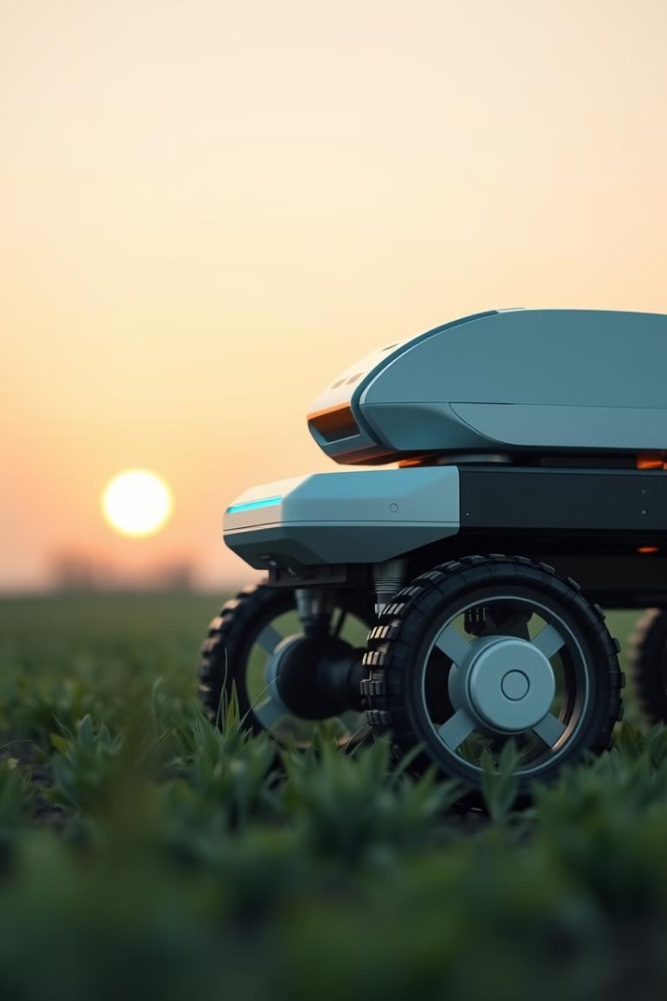
AI-Integrated Watering System
1
Communication
2
Sensors
Rover communicates with irrigation systems.
Uses moisture and weather sensors for field assessment.
3
Automation
Activates or deactivates water supply based on needs.

Slide 6
Central Control Station
Management
Synchronization
Remote Access
Manages storage, recharging, and fertilizer handling.
Controls multiple Agron AI units in large operations.
Enables data-driven decisions for farmers.

Slide 7
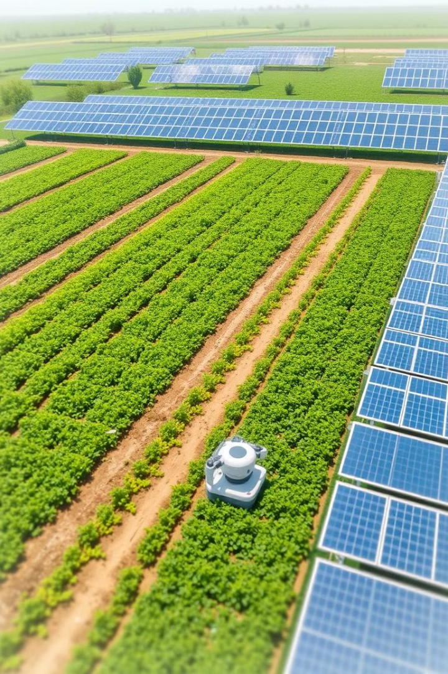
Expected Outcomes & Benefits
Increased Efficiency
Smart Irrigation
Automates harvesting, reducing human labor costs.
Reduces water wastage through real-time field monitoring.
Sustainability
Uses renewable energy sources for eco-friendly operations.

Slide 8
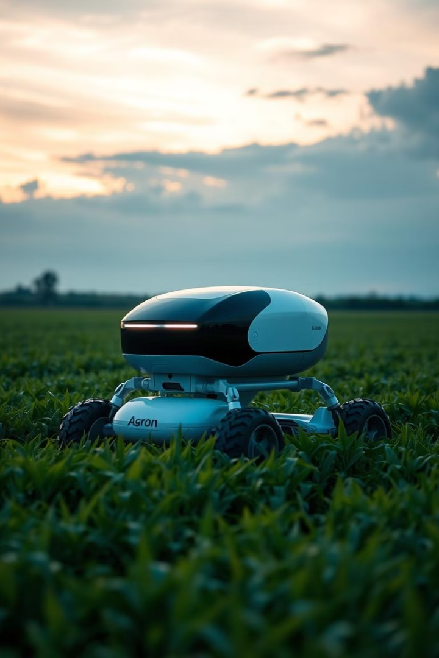
Conclusion: The Future of Farming is Here
Agron AI integrates AI, IoT, and robotics to revolutionize agriculture. It automates harvesting, irrigation, and field monitoring. It reduces labor, improves efficiency, and promotes sustainability. It is a scalable, future-ready solution for modern precision agriculture.

